Slide 1

Elementary Programming
TUIT
C++ Programming, Fall 2016
Lab #3
(II - part)

Slide 2
Read the lecture notes doing following tasks:
TUIT
Practice (II - part)
**Game: Prediction;
*Game: scissor, rock, paper;
**Game: pick a card;
*Use the && and || operators;
Game: Multiplication quiz;
*Game: Even or Odd;
*Current Time;
*Financials: currency exchange;
*Geometry: point position;
*Financial: Compare costs;
*Geometry: Point on line segment;
*Algebra: Slope – intercept form;
**Science: Day of the week;
Random point;
**Business: check ISBN – 10;
Palindrome number;

Slide 3


TUIT
1. **Game: Prediction
Write a program that generates a random two – digit integer. The program prompts the user to predict the generated number by entering a two – digit integer, and then determines the accuracy of the user’s prediction according to the following rules:
If the user’s prediction matches the generated number exactly, the accuracy is 100%. If one digit in the user’s predicted number matches a digit in the generated number, the accuracy is 50%. If none of the digits in user’s predicted number matches with the generated number, the accuracy is 0%.
Here is a sample run:
Enter the two – digit integer number: 54 Your accuracy is 100%, because generated number is 45.

Slide 4
TUIT
2. *Game: scissor, rock, paper
Write a program that plays the popular scissor, rock, paper game. (A scissor can cut a paper, a rock can knock a scissor, and a paper can wrap a rock) The program randomly generates a number 0, 1, or 2 representing scissor, rock, or paper. The program prompts the user to enter a number 0, 1, or 2 and displays a message indicating whether the user or the computer wins, loses, or draws. Here are sample runs:
Here are the sample runs:
Scissor (0), rock (1), paper (2): 1 The computer is scissor, You are rock. You won
Scissor (0), rock (1), paper (2): 2 The computer is paper, You are paper too. It is a draw

Slide 5
TUIT
3. **Game: Pick a card
Write a program that simulates picking a card from a deck of 52 cards. Your program should display the rank (Ace, 2, 3, 4, 5, 6, 7, 8, 9, 10, Jack, Queen, King) and suit (Clubs, Diamonds, Hearts, Spades) of the card.
Here is a sample run:
The card you picked is Jack of Hearts

Slide 6
TUIT
4. Use the && and || operators
Write a program that prompts the user to enter an integer and determines whether it is divisible by 5 and 6, whether it is divisible by 5 or 6, and whether it is divisible by 5 or 6, but bot both. Here is a sample run of this program:
Here is a sample run:
Enter an integer: 10 Is 10 divisible by 5 and 6? false Is 10 divisible by 5 or 6? true Is 10 divisible by 5 or 6, but not both? true

Slide 7
TUIT
5. Game: Multiplication quiz
Listing SubstractionQuiz.cpp, randomly generates a subtraction question. Revise the program to randomly generate a multiplication questionwith two integers less than 50.
Here are the sample runs:
What is 4 * 2? 1 You answer is wrong. 4 * 2 should be 8
What is 12 * 12? 144 You are correct!

Slide 8
TUIT
6. *Game: even or odd
Write a program that lets the user guess whether a randomly generated integer would be even or odd. The program randomly generates an integer and divides it by 2. The integer is even if the remainder is 0, otherwise odd. The program prompts the user to enter a guess and reports whether the guess is correct or incorrect.
Here are the sample runs:
Will my random be even or odd? (e/o): e Yes! 124 is even
Will my random be even or odd? (e/o): e No… 3125 is odd

Slide 9
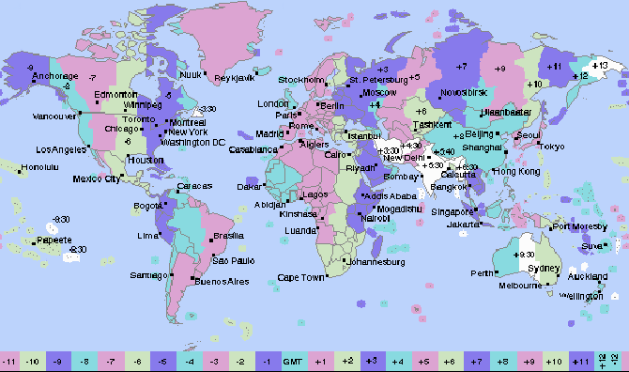
TUIT
7. *Current time
Revise program ShowCurrentTime.cpp to display the hour using a 12 – hour clock.
Here is a sample run:
Enter the time zone offset to GMT: -5 The current time is 4:50:34 AM

Slide 10
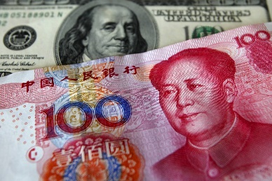
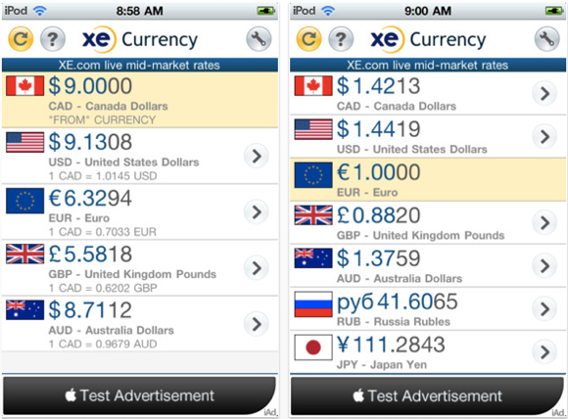
TUIT
8. *Financial: currency exchange
Write a program that prompts the user to enter the exchange rate from currency in U. S. dollars to Chinese RMB. Prompt the user to enter 0 to convert from U. S. dollars to Chinese RMB and 1 to convert from Chinese RMB and U. S. dollars. Prompt the user to enter the amount in U. S. dollars or Chinese RMB to convert it to Chinese RMB or U. S. dollars, respectively. Here is a sample run:
Enter the exchange rate from dollars to RMB: 6.81 Enter 0 to convert dollars to RMB and 1 vice versa: 0 Enter the dollar amount: 100 $100 is 681 yuan

Slide 11
TUIT
9. *Geometry:Point position
Given a directed line from point p0(x0, y0) to p1(x1, y1), you can use the following condition to decide whether a point p2(x2, y2) is on the left of the line, on the right, or on the same line:
(x1 – x0) * (y2 – y0) – (x2 – x0) * (y1 – y0)
> 0, p2 is on the left side of the line
= 0, p2 is on the same line
> 0, p2 is on the right side of the line
p1
p1
p1
p2
p2
p2
p0
p0
p0
Here are the sample runs:
Enter three points for p0, p1, and p2: 4.4 2 6.5 9.5 -5 4 p2 is on the left side of the line
Enter three points for p0, p1, and p2: 1 1 5 5 2 2 p2 is on the same line

Slide 12
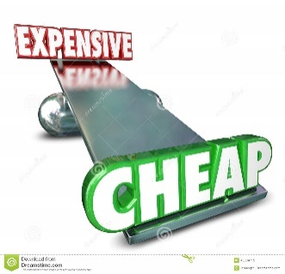
TUIT
10. *Financial: compare costs
Suppose you shop for two different packages of rice. You would like to write a program to compare the cost. The program prompts the user to enter the weight and price of each package and displays the one with the better price.
Here are the sample run:
Enter weight and price for package 1: 50 24.59 Enter weight and price for package 2: 25 11.99 Package 2 has a better price
Enter weight and price for package 1: 50 25 Enter weight and price for package 2: 25 12.5 Two packages have the same price

Slide 13
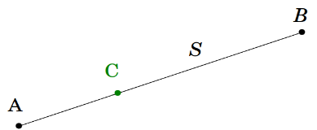
TUIT
11. *Geometry: Point on line segment
Programming point position exercise shows how to test whether a point is on an unbounded line. Revise point position exercise to enter the three points for p0, p1, and p2 and displays whether p2 is on the line segment from p0 to p1.
Here are the sample runs:
Enter three points for p0, p1, and p2: 1 1 2.5 2.5 1.5 1.5 (1.5 1.5) is on the line segment from (1, 1) to (2.5, 2.5)
Enter three points for p0, p1, and p2: 1 1 2 2 3.5 3.5 (3.5 3.5) is not on the line segment from (1, 1) to (2, 2)

Slide 14
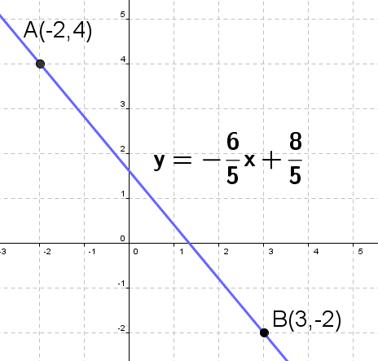
TUIT
12. *Algebra: slope – intercept form
Write a program that prompts the user to enter the coordinates of two points (x1, y1) and (x2, y2), and displays the line equation in the slope-intercept form, i.e., y = mx + b. m and b can be computed using the following formula:
$m=(y_{2}−y_{1})/(x_{2}−x_{1})$ $b=y_{1}−mx_{1}$
Don’t display m if it is 1 and don’t display b if it is 0.
Here is a sample run:
Enter the coordinates for two points: 1 1 0 0 The line equation for two points (1, 1) and (0, 0) is y = x

Slide 15

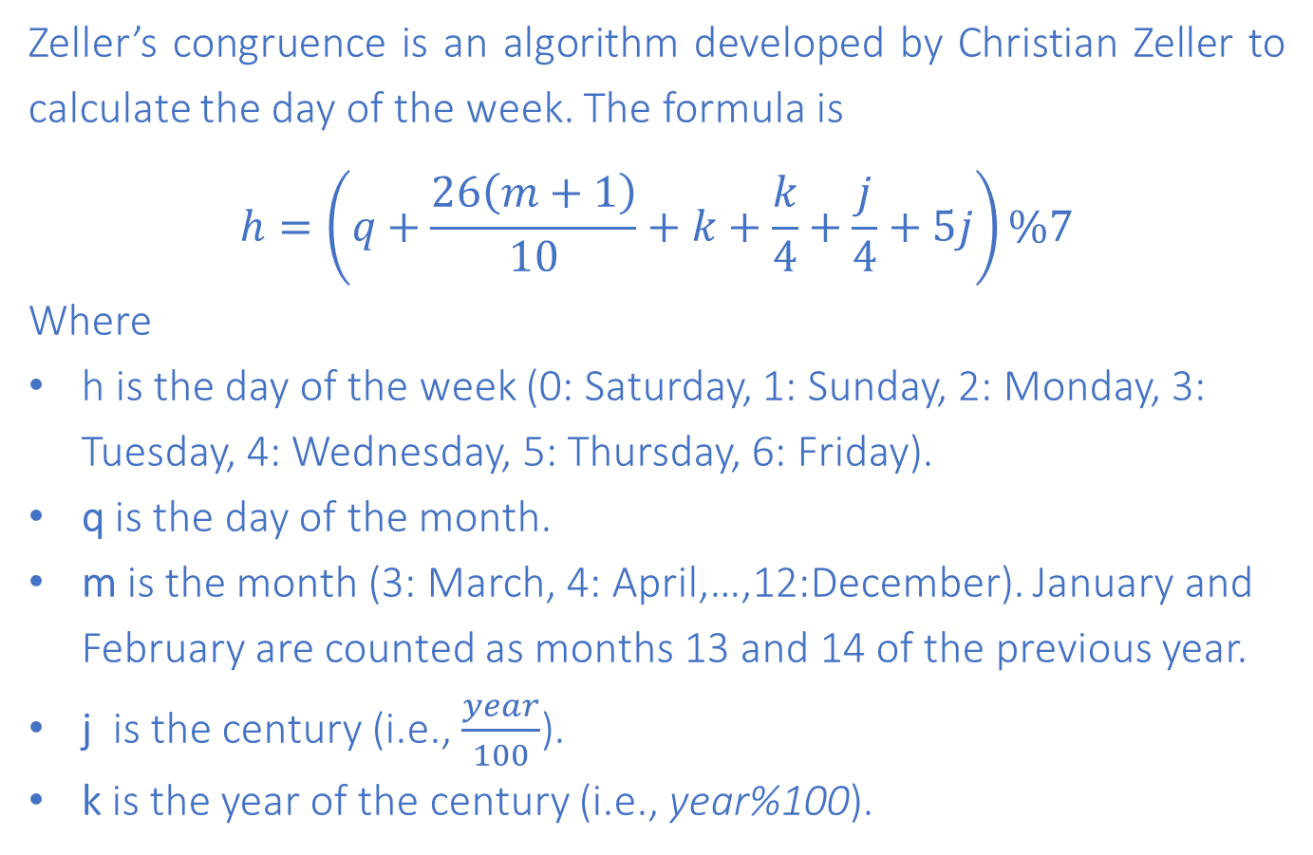
TUIT
13. **Science: day of the week
Zeller’s congruence is an algorithm developed by Christian Zeller to calculate the day of the week. The formula is
$$h=\left(q+\frac{26\left(m+1\right)}{10}+k+\frac{k}{4}+\frac{j}{4}+5j\right)\%7$$
Where
h is the day of the week (0: Saturday, 1: Sunday, 2: Monday, 3: Tuesday, 4: Wednesday, 5: Thursday, 6: Friday).
q is the day of the month.
m is the month (3: March, 4: April,…,12:December). January and February are counted as months 13 and 14 of the previous year.
j is the century (i.e., $\frac{year}{100}$).
k is the year of the century (i.e., year%100).

Slide 16
TUIT
13. **Science: day of the week
Note that the division in the formula performs an integer division. Write a program that prompts the user to enter a year, month, and day of the month, and display the name of the day of the week. Here is a sample run:
Enter year (e.g., 2012): 2015 Enter month (1-12): 1 Enter the day of the month (1-31): 25 Day of the week is Sunday
Hint: January and February are counted as 13 and 14 in the formula, so you need to convert the user input 1 to 13 and 2 to 14 for the month and change the year to the previous year.

Slide 17
TUIT
14. Random point
Write a program that displays two random coordinates in a square. The square is centered at (0, 0) with a side of 300.
y
A(16, 25)
300
x
Here is a sample run:
This (16, 25) point is in the square

Slide 18
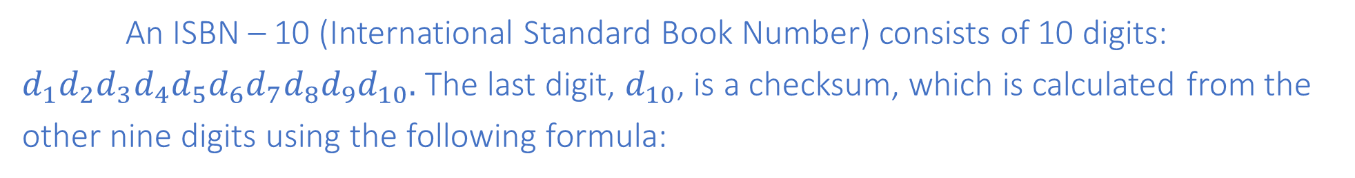
TUIT
15. **Business: check ISBN-10
An ISBN – 10 (International Standard Book Number) consists of 10 digits: $d_{1}d_{2}d_{3}d_{4}d_{5}d_{6}d_{7}d_{8}d_{9}d_{10}.$ The last digit, $d_{10}$, is a checksum, which is calculated from the other nine digits using the following formula:
$(d_{1}×1+d_{2}×2+d_{3}×3+d_{4}×4+d_{5}×5+d_{6}×6+d_{7}×7+d_{8}×8+d_{9}×9)$%11
If the checksum is 10, the last digit is denoted as X according to the ISBN – 10 convention. Write a program that prompts the user to enter the first 9 digits and displays the 10 – digit ISBN (including leading zeros). Your program should read the input as an integer.
Here are the sample runs:
Enter the first 9 digits of an ISBN as integer: 013601267 The ISBN-10 number is 0136012671
Enter the first 9 digits of an ISBN as integer: 013031997 The ISBN-10 number is 013031997X

Slide 19
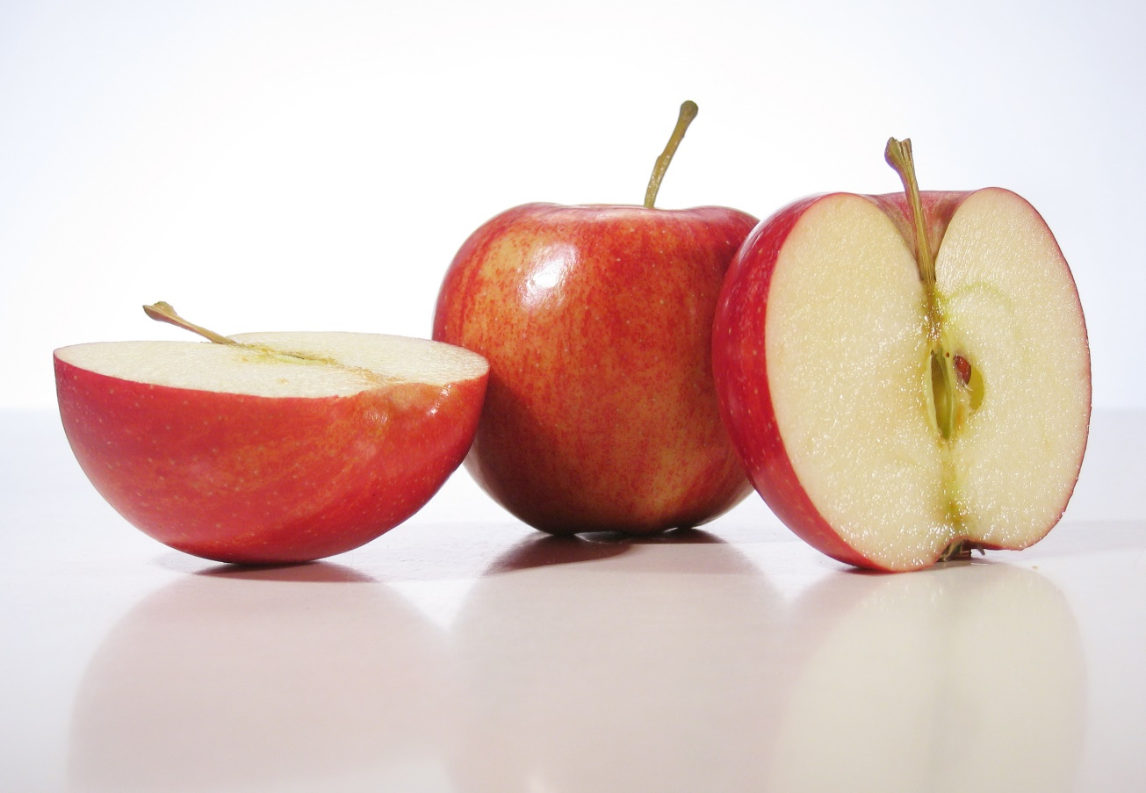
TUIT
16. Palindrome number
Write a program that prompts the user to enter a three – digit integer and determines whether it is a palindrome number. A number is palindrome if it reads the same from right to left and from left to right.
Here are the sample runs:
Enter a three-digit integer: 121 121 is a palindrome
Enter a three-digit integer: 123 123 is not a palindrome

